Slide 1
Mammography Screening
Comparing guideline recommendations
Notes:
Hello And Welcome. Thank you for joining us. Please settle in as we discuss -- Mammography Screening, Comparing CURRENT breast cancer screening guideline recommendations.

Slide 2
presented by
Notes:
Today’s Presentation, is given by the American Association of Breast Care Professionals.
And I would like to thank everyone for this invitation and opportunity.

Slide 3
Presenter
Rhonda F Turner, PhD, JD, MBA, BOCPO/L, CF-m/CMF, CHWI
25 years providing DMEPOS & clinical services, advocating for Underserved & Uninsured populations.
Currently, Executive Director - AABCP,
Research Fellow, UTHEALTH, School of Public Health
Founder: Global Breast Care Initiative, International Society of Breast Care Professionals (ISBCP/AABCP)
Notes:
I am Rhonda Turner, Executive Director of the American Association of Breast Care Professionals, your host and presenter.

Slide 4
Presentation Goals
Understand
To Understand the various CURRENT breast cancer screening recommendations.
Know
To Research your referral community’s stance on recommendations (clinical & insurance)
Resource
To be a Resource for women/referrals on the current breast cancer screening guidelines
Notes:
As breast care providers, we often are required to know basic information about breast cancer including staging, general terminology, and the possible side effects that would inhibit proper post mastectomy care
We of course. Are also expected to have a general understanding of breast screening guidelines.
This Presentation Goal’s are three-fold.
1. To Understand the various CURRENT breast cancer screening recommendations.
2. To show ways to research your referral community’s stance on recommendation both clinical and insurance.
3. To foster the idea that post mastectomy fitters are Resources. for women (and referral sources) on the current breast cancer screening guidelines

Slide 5
Post Mastectomy Providers
Point of Contact and Care for Breast Cancer Patients.
Act as a resource for breast cancer survivors, patients and family.
Notes:
So why do we learn about Breast Cancer Screening Policy? Post Mastectomy Providers are often the point of contact as well as care for breast cancer survivors.
They are viewed as trusted resources not only for patients, but for family and friends. Post mastectomy Fitters are also a resource for referral sources.
Primary care offices, RNs, NP, ancillary providers, as well as our DMEPOS colleagues, may not be up to date on the latest information.
knowing current policy, allows Certified Fitters to provide quality care while defending our patient's benefits and fighting for reimbursement.

Slide 6
Breast Cancer Screening
Defined as ANY mammography screening modality
Film or digital mammography (2D, Color)
Digital breast tomosynthesis (3D mammography)
Notes:
In the breast cancer world, “Screening “ has become synonymous with mammograms. And for this presentation, let’s assume this is the case.
But, keep in mind that screening, for most other diseases, is pre-diagnostic whereas mammograms are considered a diagnostic tool.
Breast Cancer Screening: Is currently defined by the United States Preventive Services Taskforce, (UTPSTF) which is recognized by most insurances, State, Tribal and Federal Health Services.
As ANY mammography screening modality, film or digital (2D, Color or 3D), tomosynthesis.
But its not just the UTPSTF that offers guidelines…

Slide 7
Multiple organizations have issued guidelines on breast cancer screening, but these guidelines are often conflicting.
Notes:
In the United States, multiple organizations have issued guidelines on breast cancer screening – these are often conflicting and many question the underlying motives of the guideline.

Slide 8
What Organizations Announce Breast Screening Guidelines?
American Cancer Society
Canadian Task Force
American College of Physicians
American College of Obstetricians and Gynecologists
American College of Radiology
American Academy of Family Physicians
International Agency for Research on Cancer
U.S Preventive Services Task Force
Centers for Disease Control (CDC)
American College of Breast Surgeons
Notes:
What Organizations Announce Breast Screening Guidelines? As you can see there is a variety of originations that offer their opinions on what is appropriate screening.

Slide 9
But Who else “sets” breast cancer screening guidelines for women?
???
Notes:
But these are all research and academic and non profit organizations, we would expect them to have opinions on public health.
who else sets breast cancer screening guidelines for women?

Slide 10
Physicians through informed consent and shared decision making with patients.
Insurance Carriers
Notes:
Physicians - through informed consent and shared decision making with their patients.
and ultimately, Insurance Carriers be setting reimbursement policy.
On paper, reimbursement policies are determined by “evidence-based science.”
But realistically, we all know that may not always be the case. And, unfortunately, the application and enforcement of these reimbursement policies can be quite arbitrary.

Slide 11
Confused yet?

Slide 12
just think, if your confused, how do your clients and patients sort through the information?
Notes:
So, just think, if your confused, how do your clients and patients sort through the information?

Slide 13
Even though screening education is not usually in a Fitter’s wheelhouse, It is important to know the facts.
Notes:
Even though screening education is not usually in a Post Mastectomy or Lymphedema Fitter’s wheelhouse, It is important to know the facts.

Slide 14
2019, the American College of Physicians (ACP) issued new guidance on breast cancer screening for average-risk women that spurred media interest.

Slide 15
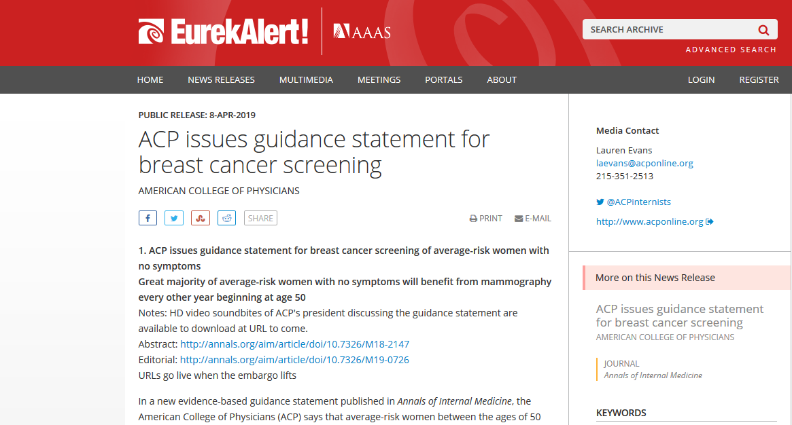
But the “media” doesn’t always get it right.
Notes:
But the “media” doesn’t always get it right.
ACP Recommended average risk women, with no symptoms will benefit from mammography every OTHER year beginning at age 50.
This was a change in the previous general consensus of yearly, at 45. This was seized upon by insurance companies, advocacy groups that claim mammography is more harmful than helpful.
One article in the Annals of Internal Medicine and the subsequent support of the American College of Physicians, changed many things.

Slide 16
Which screening guidelines do your insurances or referrals recommend?
Notes:
Which screening guidelines do your insurances or referrals recommend?

Slide 17
Breast Cancer & Screening Terminology
Notes:
Let’s take a look as some of the breast cancer and screening terminology that is used.

Slide 18
What categories are reviewed?
Women 40 – 49 with average risk
Women 50 – 74 with average risk
Women >85 with average risk
Women with dense breasts
Women at higher than average risk
Use of adjuvant technology—other than 2D mammograms.
NOTE: Current Recommendations being updated.
Notes:
Categorizing allows criteria to be researched through evidence-based practice.
Most studies on the efficacy of mammogram screening categorize women by age, risk and breast density.
Read slide

Slide 19
What is considered “average risk”
No family history of breast cancer
No genetic mutation
No chest radiation
Notes:
What is “average risk”?
No family history of breast cancer, no genetic mutation, and no chest radiation.

Slide 20
Above-Average Risk
Family History (first degree relatives)
Gene Mutations: BRCA1 or BRCA2
ATM, CDH1, CHEK2, NBN, NF1, PALB2, PTEN, STK11 or TP53
Notes:
Above average risk is defined as
Family history – first degree relatives
Or having Gene mutations: BRACA1 BRACA2 or Both 1 &2
Keep in mind, while the most common and most studied, BRACA is not the only gene variation that can give rise to breast cancer.

Slide 21
Above-Average Risk
Personal history
invasive breast cancer or
ductal carcinoma in situ (DCIS) / lobular carcinoma in situ (LCIS)
atypical hyperplasia
Radiation treatment to the chest area between ages 10-30
Notes:
Above Average Risk includes a personal history of invasive breast cancer or ductal carcinoma in situ or lobulr carcinoma in situ or atypical hyperplasia, It also includes a history of radiation treatment to the chest area between the ages of 10 - 30

Slide 22
Dense Breasts
Density was first identified as a risk factor in 1976
2013: Discovered that increase risk 4-6 Fold
Notes:
In recent years, breast density has also been recognized as a RISK FACTOR.
Density was first identified as a risk factor in 1976
2013, Discovered that Density increase a woman’s risk for breast cancer - 4-6 Fold

Slide 23
Dense Breasts
Greater risk for developing breast cancer.
Less likely to have breast cancer detected by analog or full-field digital mammography alone.
Notes:
In General, having Dense Breasts, means you are at
Greater risk for developing breast cancer.
Less likely to have breast cancer detected by analog or full-field digital mammography alone.

Slide 24
Controversial Risk Factor (ACR)
Modest Risk Factor (ACOGYN)
Unsubstantiated
Independent risk factor for the development of breast cancer
Notes:
Some organizations consider Dense Breasts Risk to be unsubstantiated.
Independent risk factor that requires more research
Controversial Risk Factor by the American College of Radiologists
And a modest Risk Factor by the American College of Obstetrics and Gynecologists.

Slide 25
Most published Breast Cancer Screening Guidance centers around Benefits vs Risks of breast cancer screening.
Notes:
We’ve been discussing Risk factors. Most published Breast Cancer Screening Guidance centers around the comparison of Benefits vs Risks of breast cancer screening.

Slide 26
Screening Benefits
Catching the cancer early enough to treat
Confirming you do not have cancer
Notes:
SCREENING BENEFITS are defined as and include
Catching the cancer early enough to treat
Confirming you do not have cancer

Slide 27
Risks
Possible Morbidity from tests and treatments–
anxiety, treatment, biopsies, surgeries, chemo for cancers that “may not” effect a patient.
False positives -- shown to effect “lower uptake” of future screening.
Perception of radiation accumulation
Pain
Notes:
SCREENING RISKS
include

Slide 28
Clinical Breast Exam
Current guidance on CBE by ACP, CTF, USPSTF
No evidence that a clinical breast exam actually makes a difference in morbidity or mortality for women.
slightly increased rate of detecting breast cancer, data is not clear that those wouldn't have been detected in a reasonably similar time frame
Notes:
CLINICAL BREAST EXAM
For decades, the Clinical Breast Exam (CBE) and the Self-Breast Exam were the foundation stone in the fight against breast cancer.
As of 2016 & 2019 Updates, the approach to the Clinical Breast Exam has changed considerably
According to the American College of Physicians, the Cancer Treatment Foundation, and the United States Preventive Task Force:
There is -- No evidence that a clinical breast exam actually makes a difference in morbidity or mortality for women.
And -- there is a slightly increased rate of detecting breast cancer, data is not clear that those wouldn't have been detected in a reasonably similar time frame

Slide 29
Self Breast Exams
Current consensus
“there's no evidence that it helps”
it increases anxiety
leads to a lot of unnecessary tests and procedures
no demonstrable benefit (ACP)
Notes:
With regards to Self Breast Exams:
The current consensus is that: “there's no evidence that it helps”
That the push for self breast exams: increase anxiety, leads to a lot of unnecessary tests and procedures and according to the American College of Physicians, there is no demonstrable benefit (ACP)

Slide 30
These recommendations are different from every other country on the planet!
Notes:
These recommendations are different from every other country on the planet!

Slide 31
Another factor that has crept into Screening Guidelines
Overdiagnosis
Notes:
Overdiagnosis is Another factor that has crept into the discussion of Breast Cancer ( and other cancer) Screening Guidelines.

Slide 32
Overdiagnosis
Overdiagnosis refers to the detection of a cancer that would not otherwise become symptomatic during a woman's lifetime.
Increasing issue | “buzzword”
Depending upon estimates and how often mammography is used for screening, aggressive screening with mammography can lead to overdiagnosis in over 20% of cases. (ACP)
Notes:
Overdiagnosis refers to the detection of a cancer that would not otherwise become symptomatic during a woman's lifetime.
Increasing issue | “buzzword”
According to the American College of Physicians, Depending upon estimates and how often mammography is used for screening, aggressive screening with mammography can lead to overdiagnosis in over 20% of cases. (ACP)

Slide 33
Let’s take a Look. Breast Cancer Screening Recommendations (Guidelines)
Notes:
Let’s take a Look.
Breast Cancer Screening Recommendations

Slide 34
Remember, Breast Cancer Screening Guidance centers around Benefits vs Risks (Costs) of breast cancer screening.

Slide 35
American College of Physicians (2019)
benefits don't outweigh the risks and women generally should not be getting mammograms between 40 and 49.
Mammograms every other year age 50-74

Slide 36
American Society of Breast Surgeons (ASBrS)
Under 25-39, formal risk assessment
Annual mammograms beginning at age 40
Screening mammography should cease when life expectancy is <10 years
Dense Breast & Higher than average risk, 3D annually.

Slide 37
American College of OB-GYN (2017)
Emphasis on “shared decision making”
option at age 40
50-75 annually/biennially based on health

Slide 38
National Comprehensive Cancer Network
CBE 25-39
annual mammograms, starting at age 40

Slide 39
American Cancer Society
annual mammograms starting around age 45
have the option to start yearly at 40
55+ switch to every other year depending on health

Slide 40
USPSTF
United States Preventative Services Task Force
No benefit (to overall mortality) ages 25-39
Informed decision-making with a health care provider ages 40-49
Every 2 years ages 50-74
Medicare, Medicaid & most major insurance carriers

Slide 41
Making Sense of the changing information
Called recommendations / guidelines
Most Recent
organizational website
Insurance website
Many are just “Organizational Recommendations”
Physicians may differ
Shared decision making encourages patient-doctor communication

Slide 42
RESOURCES
USPTF GUIDELINES: https://youtu.be/WVhdNpxkIEQ
SUSAN G KOMEN https://ww5.komen.org/BreastCancer/
AMERICAN CANCER SOCIETY https://www.cancer.org/cancer/breast-cancer/
National Cancer Care Network: https://www.nccn.org/
Boyd NF, Martin LJ, Yaffe MJ, et al. (2011). Mammographic Density and Breast Cancer Risk: Current Understanding and Future Prospects. Breast Cancer Res. 2011; 13(6):223.
Check CM, Chun JE, Schnabel FR, et al. (2012). The Relationship of Mammographic Density and Age: Implications for Breast Cancer Screening. AJR Am J Roentgenol. 2012; 198(3):W292-W295.
Wolfe JN. (1976). Breast Patterns as an Index of Risk of Developing Breast Cancer. AJR Am J Roentgenol. 1976; 126(6):1130-1139.

Slide 43
Questions?
Find us at aabcp.org
We are always online to chat.

Slide 44
Thank you

Slide 45
AABCP
Web: http://www.aabcp.org
Email: policy@aabcp.org
Phone: 703 349 7014
Twitter: @speakoutaabcp
LinkedIn: AABCP
Podcast: Politics of Breast Care

